Slide 1
Impact of Liquor Consumption on GPA
Hamza Siddique Ahmed
Asish Pabbisetty
Shweta Batra
Sunanda Nagareddygari
DATA MINING
GROUP 7

Slide 2
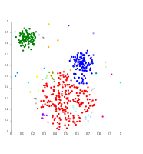
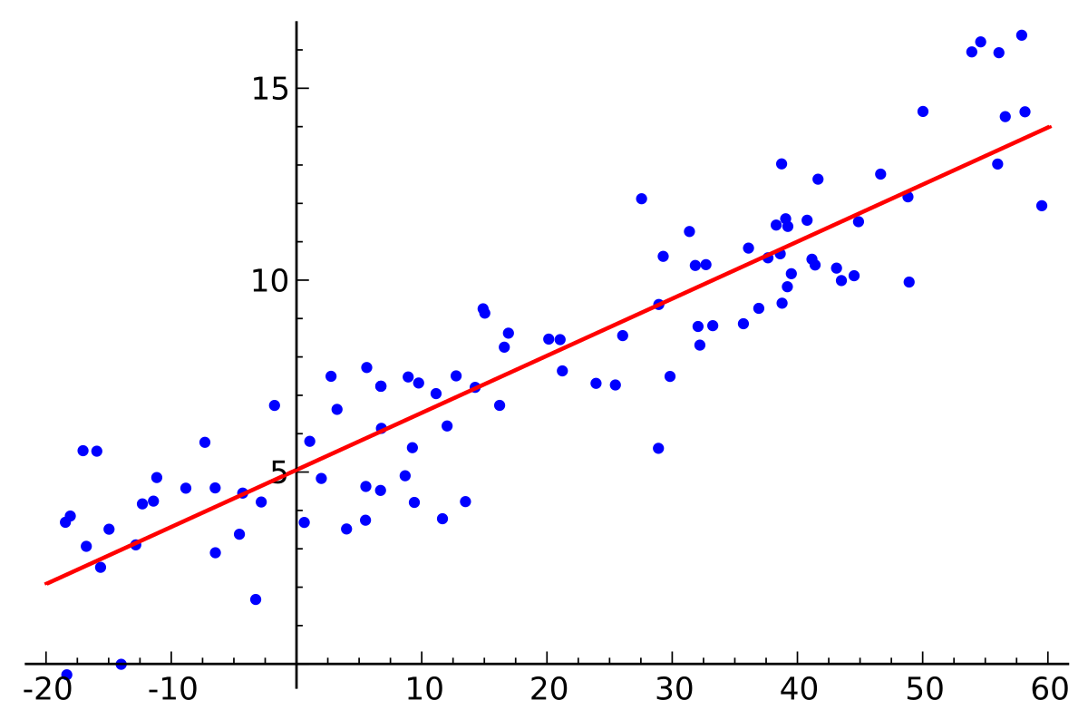
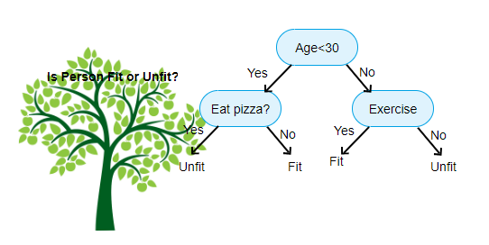
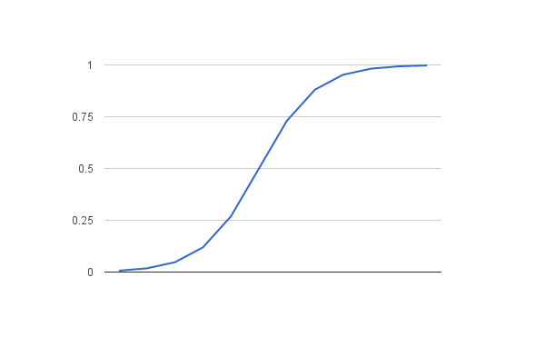
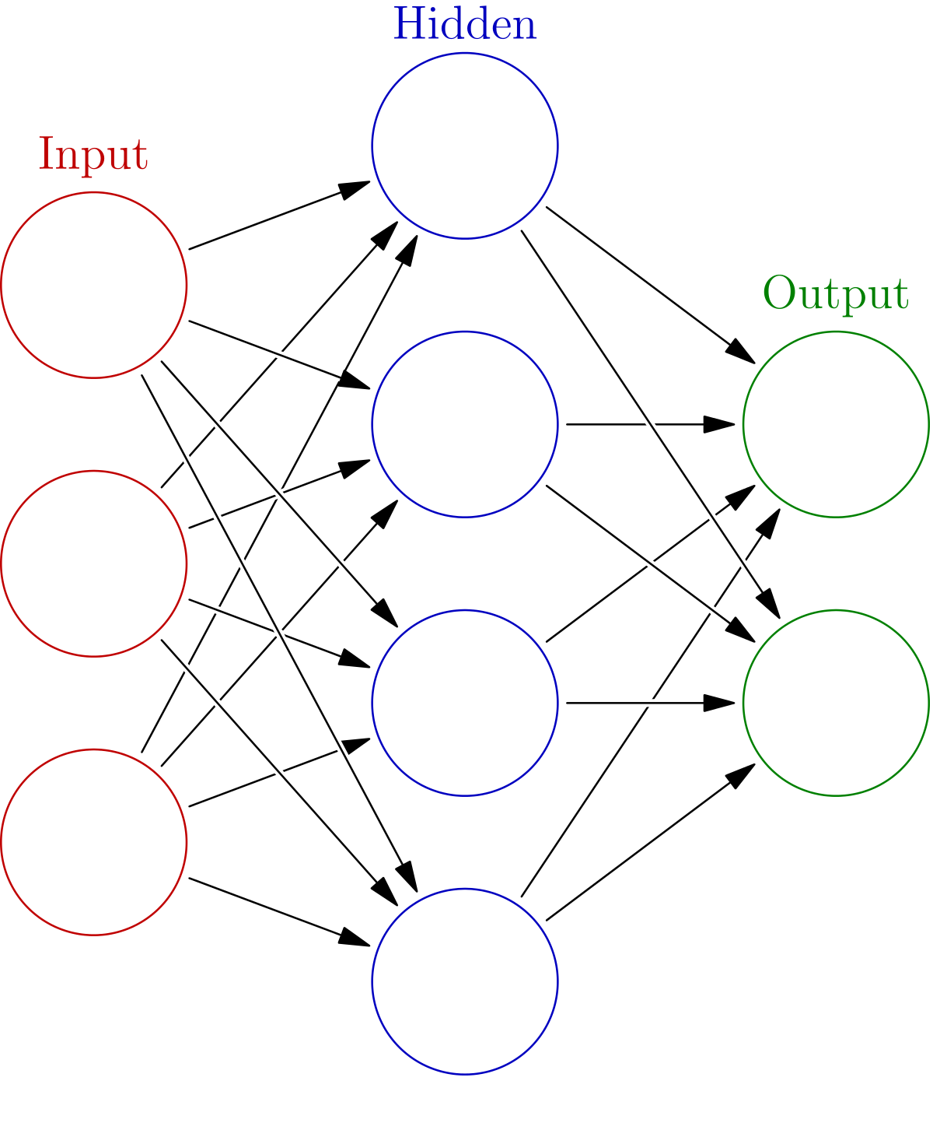
OBJECTIVE
Models Used:
Cluster Analysis
Linear Regression
Decision Tree
Logistic Regression
Neural Networks
Our project will aim to determine how alcohol consumption influences the GPA of two groups of students taking Math and Portuguese.
Our target variable will be GPA and the predictors can be workday alcohol consumption and weekend alcohol consumption
Dataset Used: https://www.kaggle.com/uciml/student-alcohol-consumption -> Second hand data

Slide 3
We REJECTED:
Examples of attributes used:
Age
Study time
Activities
Internet
Romantic
Daily Alcohol Consumption
Weekend alcohol consumption
G1 - > First Period Grade
G2 - > Second Period Grade
Because these variables have a high collinearity with variable G3 which is the final grade

Slide 4
Cluster Analysis

Slide 5
Introduction
Cluster: A group of objects
Objects with similarity fall into same cluster
Objects with dissimilarity fall into different cluster
Clustering is unsupervised classification technique: it does not contain any target variable. It mainly focuses on classifying the data according to similarity

Slide 6
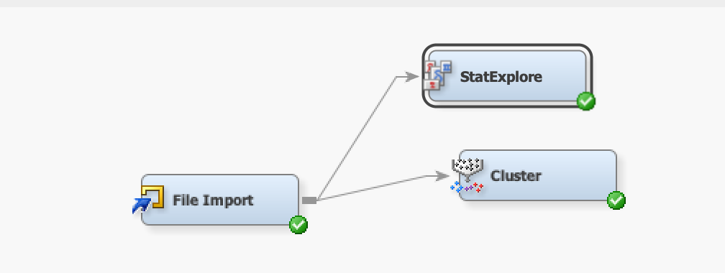
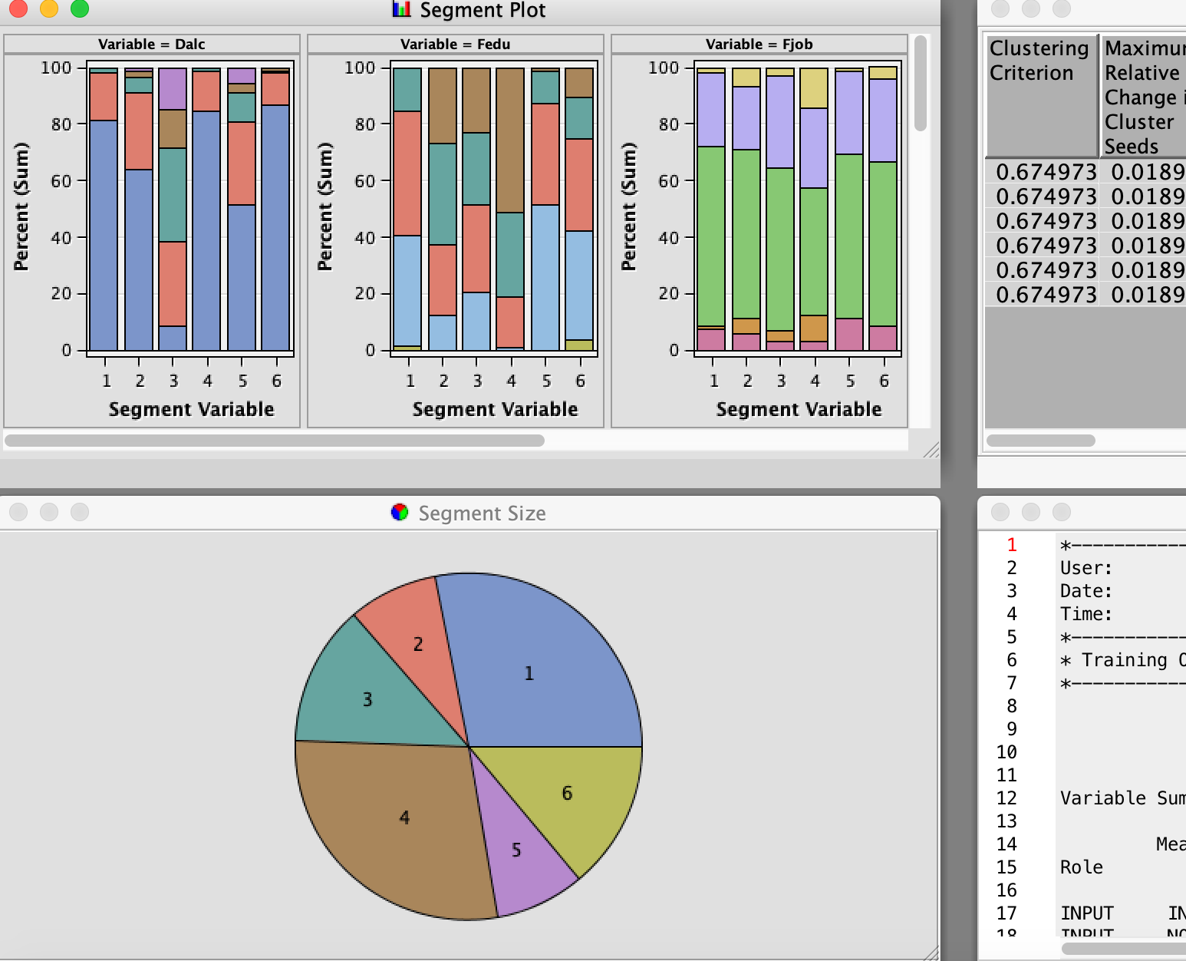
In our project
We initially just added a cluster node and ran the model
It resulted us with 6 clusters, Which is complex to interpret cluster’s characteristics

Slide 7
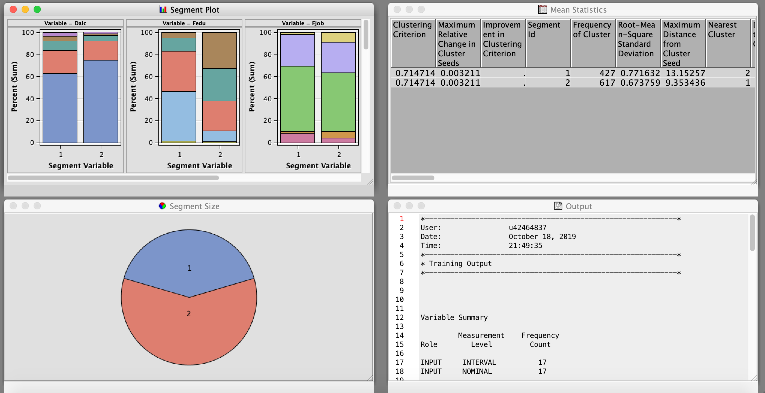
Continue…
We specified number of clusters to 2
After Analysis of segment plot and mean statistics, we got to know
CLUSTER 1 - ‘WEAKER STUDENTS’ : The students who have more free time, who drink regularly on weekdays as well as on weekends, who have more travel time, who have no internet, who don’t have school support tend to get poor overall grade
CLUSTER 2 – ‘BRIGHTER STUDENTS’ : The students who don’t drink regularly on weekdays as well as weekends, who have less travel time, who have internet, who have school support tend to get good overall grade

Slide 8
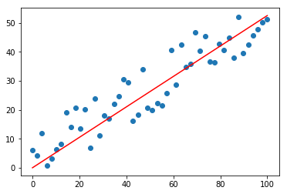
Linear Regression

Slide 9

Introduction
Linear regression is a Predictive analytics approach.
Linear regression is a linear approach for modeling the relationship between a dependent variable and one or more independent variables.
It is basically used to predict the value for the dependent variable based on the model.

Slide 10
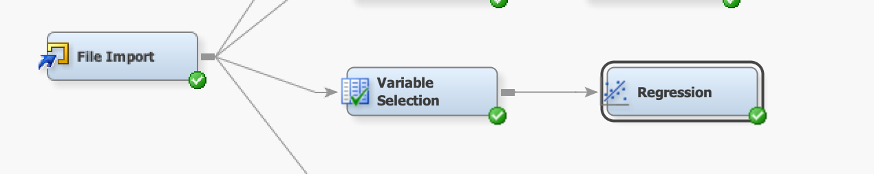
In our project
To get the most meaningful inputs for the model and for reducing the inputs for processing and analysis, we used the variable selection node.
The resulting variables were fed into the regression model as inputs.
After running the model, the significant variables were resulted -failures, go out, health, romantic, schoolsup (school support), studytime.

Slide 11
Continue…
Linear regression is a linear approach for modeling the relationship between a dependent variable and one or more independent variables.
The F-test value resulted to be less than 0.05. Therefore, model is significant.
Multi linear regression line equation is:
G3= Estimate(Intercept)+failures* Estimate(failures)+go out* Estimate(go out)+health * Estimate(health)+romantic * Estimate(romantic)+ school sup* Estimate(school sup)+ studytime*Estimate(studytime).

Slide 12
Decision Trees

Slide 13
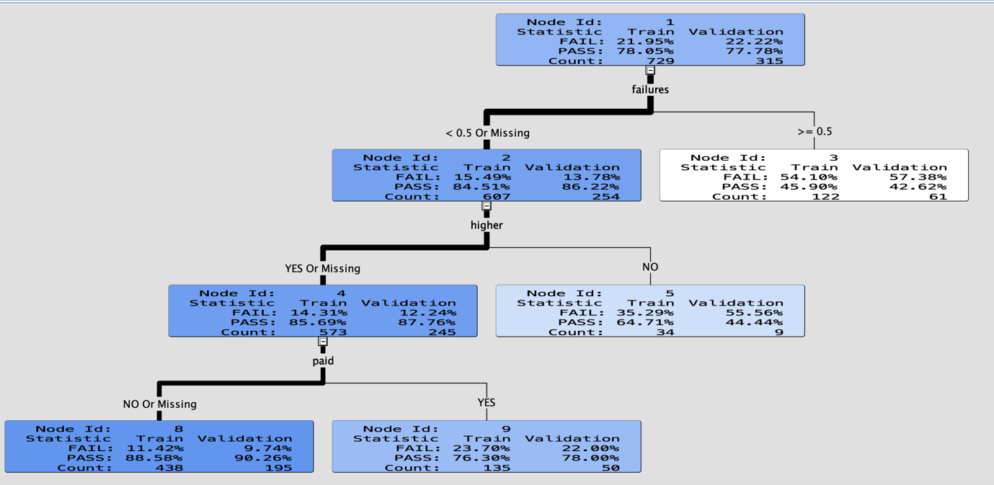
In our project
No missing values – No need of replacement node or to impute to clean the data.
Next, the data partition node was added to split the data into 70% training data and 30% validation data.
Further, the decision tree was created using average squared error as model assessment statistic.
The outputs are as follows-
The weight of the line is heavier for the node where most observations are located.
Darker the node, more the purity of node. Which means, the node which is darker tells you that the node has number of observations with “Yes”
If the node is white, there are more number of observations with a “No”
In failures split, if it is less than 0.5 student has more probability of passing the subject. The pass percentage is 84.51% in validation data.

Slide 14
Continued..
If the failures are greater than 0.5, the students has more than 54% of chance to fail in that subject
In the second split higher, if the student has a interest about pursuing his/her higher studies he has probability of more than 85% to pass the subject. If he doesn’t have any thought of doing higher studies he has 65% of pass rate.
In the third split paid, if the student has paid for extra hours with in subjects, he/she has 77% of passing that subject.
In the third split paid, If the students doesn’t require any extra studying hours for that subject they have 89% of passing the subject. Since because they could have good knowledge with that subject. So they won’t require to pay extra amount.

Slide 15

Decision Tree Conclusion:
From this decision tree model, we cannot directly derive that Alcohol consumption has any impact the overall grades of the students. This model only tells you whether the students pass or fail the subject or students get good grade or not. Because, this is classification type model, it has the target variable as categorical variables.

Slide 16
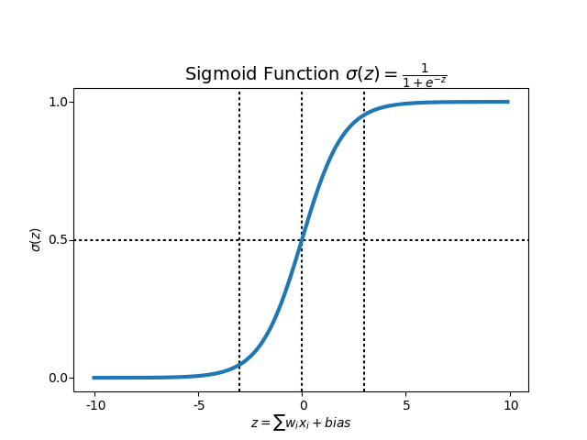


LOGISTIC REGRESSION
Logistic regression is a kind of statistical analysis that is used to predict the outcome of a dependent variable based on prior observations.
$p$: the probability that event Y occurs
$\frac{p}{1−p}$: odds that event Y occurs
$\ln\left(\frac{p}{1−p}\right)$: Natural log of the odds (log odds), or logit

Slide 17
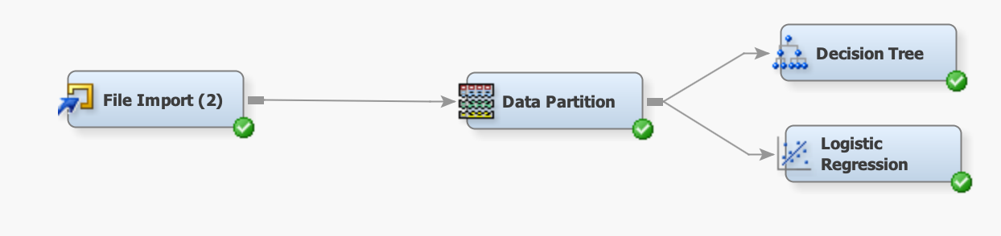
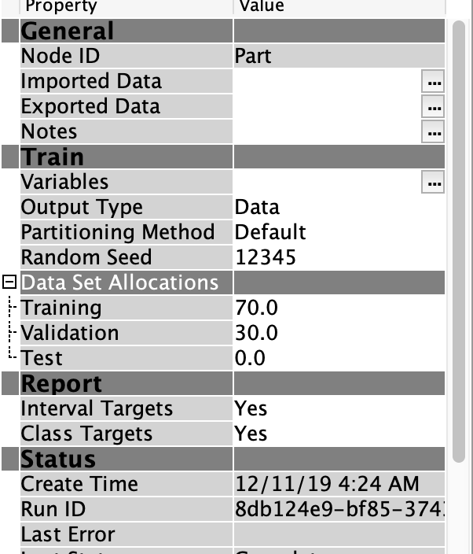
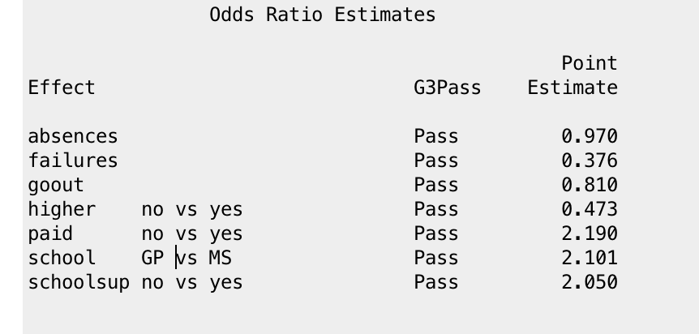
In our project, we added data partition node where we partitioned the data into 70 percent training data and 30 percent validation data.
G3Pass is the target variable. In this model we considered, if G3 value <= 10 then G3Pass is Fail where as G3 value > 10 then G3Pass is Pass.
Odds = p/1-p
Odds Ratio : Odds Ratio for a variable in logistic regression is how the odds change for an unit increase in the independent variable keeping the other variables constant.

Slide 18
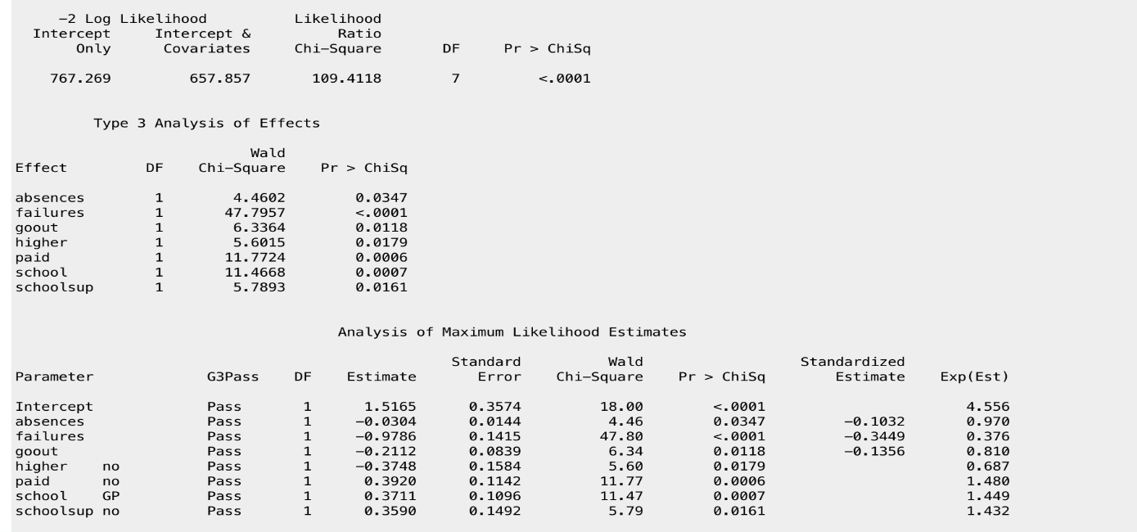
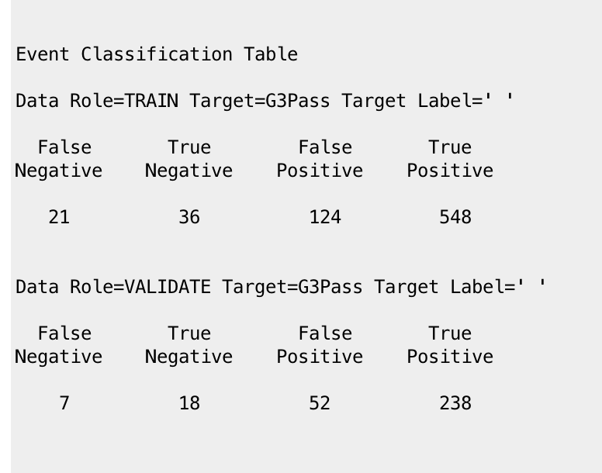
Logistic Regression Equation for this model =
log(p/1-p) = 1.516 – 0.0304absences – 0.9786 failures – 0.2112 gout – 0.3748 + 0.392 paid + 0.3711 + 0.3590 school sup)
Accuracy of the model: can be determined by using validating data.
Accuracy= TP+TN/(FN+TN+FP+TP)=
238+18/(7+18+52+238)= 0.81 =
81% accuracy
Further when we added Logistic regression, the results showed that the model is significant as P value associated with ChiSq is less than 0.05.

Slide 19
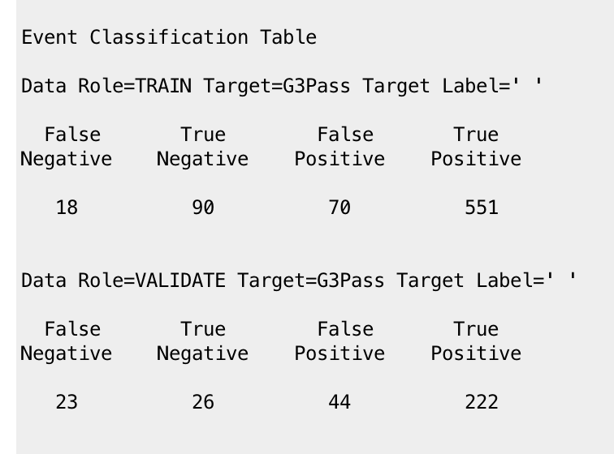
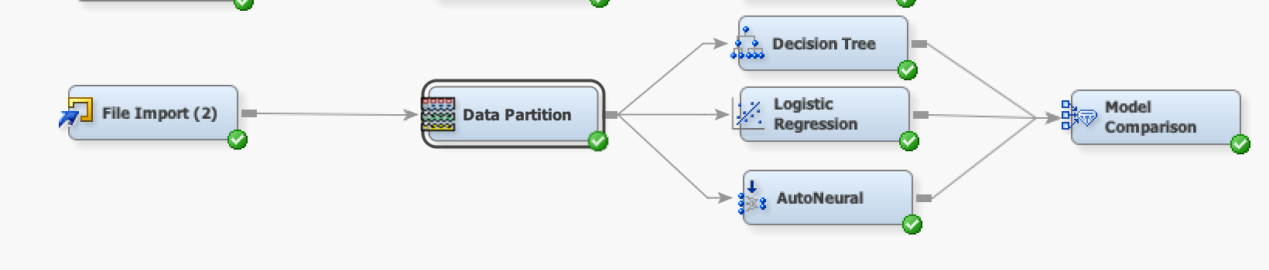
NEURAL NETWORKS
Accuracy of the model: can be determined by using validating data.
Accuracy= TP+TN/(FN+TN+FP+TP)=
222+26/(23+26+44+222)= 0.78 =
78% accuracy

Slide 20
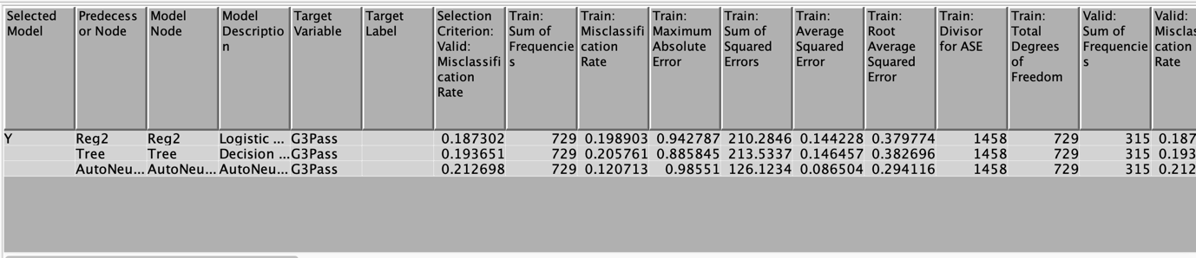
MODEL COMPARISON NODE
The Criteria for the model comparison is the Misclassification Rate.
As the logistic regression has the minimum Misclassification Rate among the three models it has been chosen as the best model for this data.

